Slide 1
Intent to Register
March 2024

Slide 2
Why ITR?
To inform the Registrar that you will be returning.
Adjudication into a module for the following school year to allow priority for courses.
To set up a line of registration to add courses in June/July web registration.
Check your emails for instructions.
Timeline-Now until March 31st.
Module Results in late May early June.

Slide 3
To Access a Biology Module from first year
MUST have a 60%+ average in Biology 1001A or 1201A and 1002B and 1202B (no exceptions).
Chemistry must be passed, a minimum 60% for the Honors Modules.
1.0 from the listed math courses
0.5 from Physics
1.0 from a faculty other than Science.
Math and physics can be delayed until 2nd year.

Slide 4
Modules offered by Biology
4 Honors Specializations (10.0 credits):
Animal Behaviour (with Dept. of Psychology)
Biology
Biodiversity and Conservation
Genetics
Genetics & Biochemistry (with Dept. of Biochemistry)
Synthetic Biology
Also:
Specialization in Biology (9.0 credits)
Major in Biology (6.0 credits)
Major in Ecosystem Health (6.0 credits)
Major in Genetics (6.0 credits)
Minor in Biology (4.0 credits)
Minor in Genetics (4.0 credits)

Slide 5
How to choose courses
Check the module you hope to enter
Read the course descriptions to decide which courses you want to want to take in the future and get the appropriate prerequisites before enrolment.
Balance out your workload, divide up the essay and lab courses if possible, to different terms.
SEEK OUT counselling to ensure that you can proceed.

Slide 6
Double Major vs. Honors Specialization
Double Major | Honors Specialization
More flexible Not able to access 4000 level courses Allow students to have a broad understanding of their interests Limited research experience May have common credits –different regulations depending on the modules | Requires courses at 4000 level Honors Thesis Opportunity is a choice in Biology Extensive background in a specific discipline Recommended for students interested in Graduate studies

Slide 7
How to access Honors Modules
Biology is NOT a Limited Program – if you have the appropriate grades, you will be admitted.
After first year we forgive the 70% on the 3.0 principal courses (must have the 60% in Biology and Chemistry)
Modular averages become the focus.
Check the calendar and the Biology website for announcements and see your Biology counsellor for assistance in balancing your workload.

Slide 8
Breadth Requirements
At least 1.0 course from each category:
Category A – Social Sciences
Anthropology, Economics, Geography, Psychology or Music etc.
Category B – Arts and Humanities
Classical Studies, Film Studies, Languages, Visual Arts
Music/Dance are NOT considered Category B
Category C – Science
Biology, Engineering etc.,
Please check the calendar online for all listings.
Must be completed by graduation.

Slide 9
Biological Science | Medical Science | Health Science
Diversity of organisms Integrates cellular, organism, community, and ecosystem levels | Explore the molecular, cellular, and systemic organization of the human body | Promotes health and wellness Reviews how health care is provided
Modules Offered
Animal Behaviour Biology Genetics Genetics & Biochemistry | Anatomy and Cell Biology Biochemistry Microbiology and Immunology Physiology | Comm. Rural Health Development Health Promotion Health Sciences Rehabilitation Sciences
Course Selection – Year 1 & 2
Year 1: Bio, Chem, Math, Phys Year 2: Principal science courses Ecology, Evolution | Year 1: Bio, Chem, Math, Phys Year 2: Principal science courses Entry courses in various disciplines | Year 1: Bio, Health and Wellness Year 2: Anatomy, Measurement & Analysis
Course Selection – Year 3 & 4
Various disciplines within Biology Field Courses available | Basic Med Sci courses in year 3 Various disciplines within Med Sci | Ethics & Health, Health Policy, Health Promotions, Health Issues
Career Opportunities
Graduate studies (MSc/PhD) Professional School Employment in: Public sector Business and industry Teaching Law | Graduate studies (MSc/PhD) Professional School Employment in: Public sector Business and industry Teaching Law | Health Promotion Community health programming Public sector administration and policy development Biomedical ethics Business and industry Non-profit sector

Slide 10
Summer Courses Offered in Biology
Summer Calendar Check out details on Summer activation and available courses.
Various Field courses 3220Z, 4257Z or 4258Z
Biology 2244b, 2382A, 2483B and 2581B via distance studies.
Summer Day: Biology 1001A and 1002B.

Slide 11
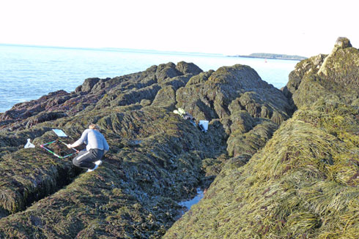
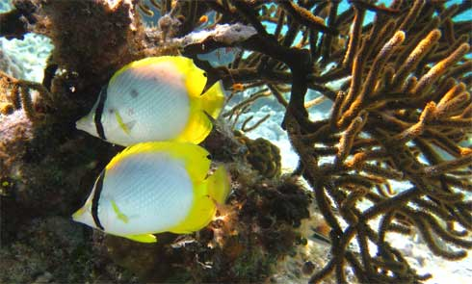
Field Courses through OUPFB.ca
Want to experience what research is like in the real world? A field course may be for you!!
Students may take up to three half credits as Field Courses in their Biology degree
Biology 3220Z, 4257Z, 4258Z
Topics include:
Tropical Marine Biology
Forest Ecology
Marine Biology
other areas of interest from Biology Departments across Ontario
Wonderful experience by all students
www.oupfb.ca
Contact Brenda Beretta (bberetta@uwo.ca)
North Campus Building Room 301A for more information

Slide 12
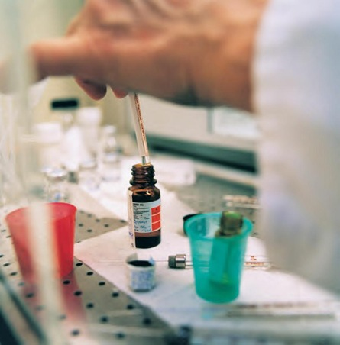
Western Science Internship Program
8 – 16 months practical science career-related placement and receive 1.0 credit
Average annual salary of $36,000
Paid hands-on work experience
Mentored by professionals in the field
Eligible to 2nd and 3rd year students enrolled in BSc Honors programs

Slide 13
Important Sites-bookmark them!
Academic Calendar
Has the most current information available.
Many of your questions can be answered here.
www.westerncalendar.uwo.ca/
www.uwo.ca/biology-undergrad page
www.uwo.ca/sci/counselling
Your Biology counsellors:
Brenda Beretta, bberetta@uwo.ca
Dr. Tim Hain thain@uwo.ca

